Slide 1
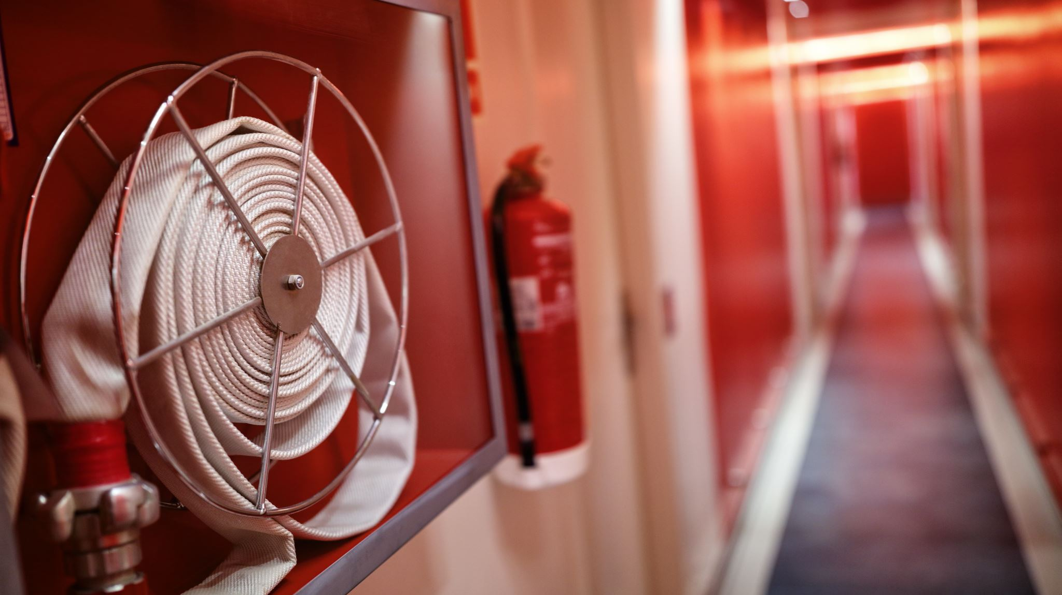
Fire Extinguisher Training
Craig Findley, CPTM, COSS
Former League City, TX Volunteer Firefighter

Slide 2

In the Event of a Fire:
Your Responsibility
If in the office or at home:
  Pull the Alarm and Call 911
At a Plant Location:
  Call the Control Room

Slide 3
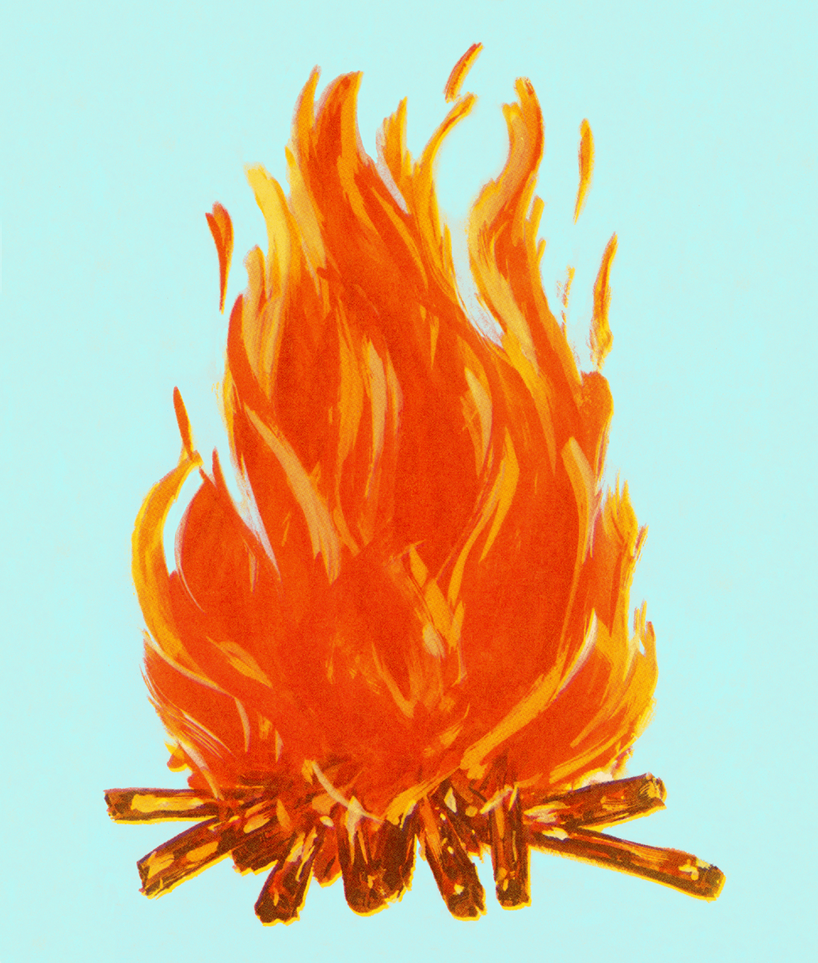



Fire Tetrahedron
HEAT
Chain reaction that allows a fire to ignite.
Required energy to ignite a fire and maintain it.
OXYGEN
FUEL
CHEMICAL
REACTION
Sustains Combustion by Reacting to Fuel.
Solid, Liquid, Gas, or Plasma that supports combustion.

Slide 4
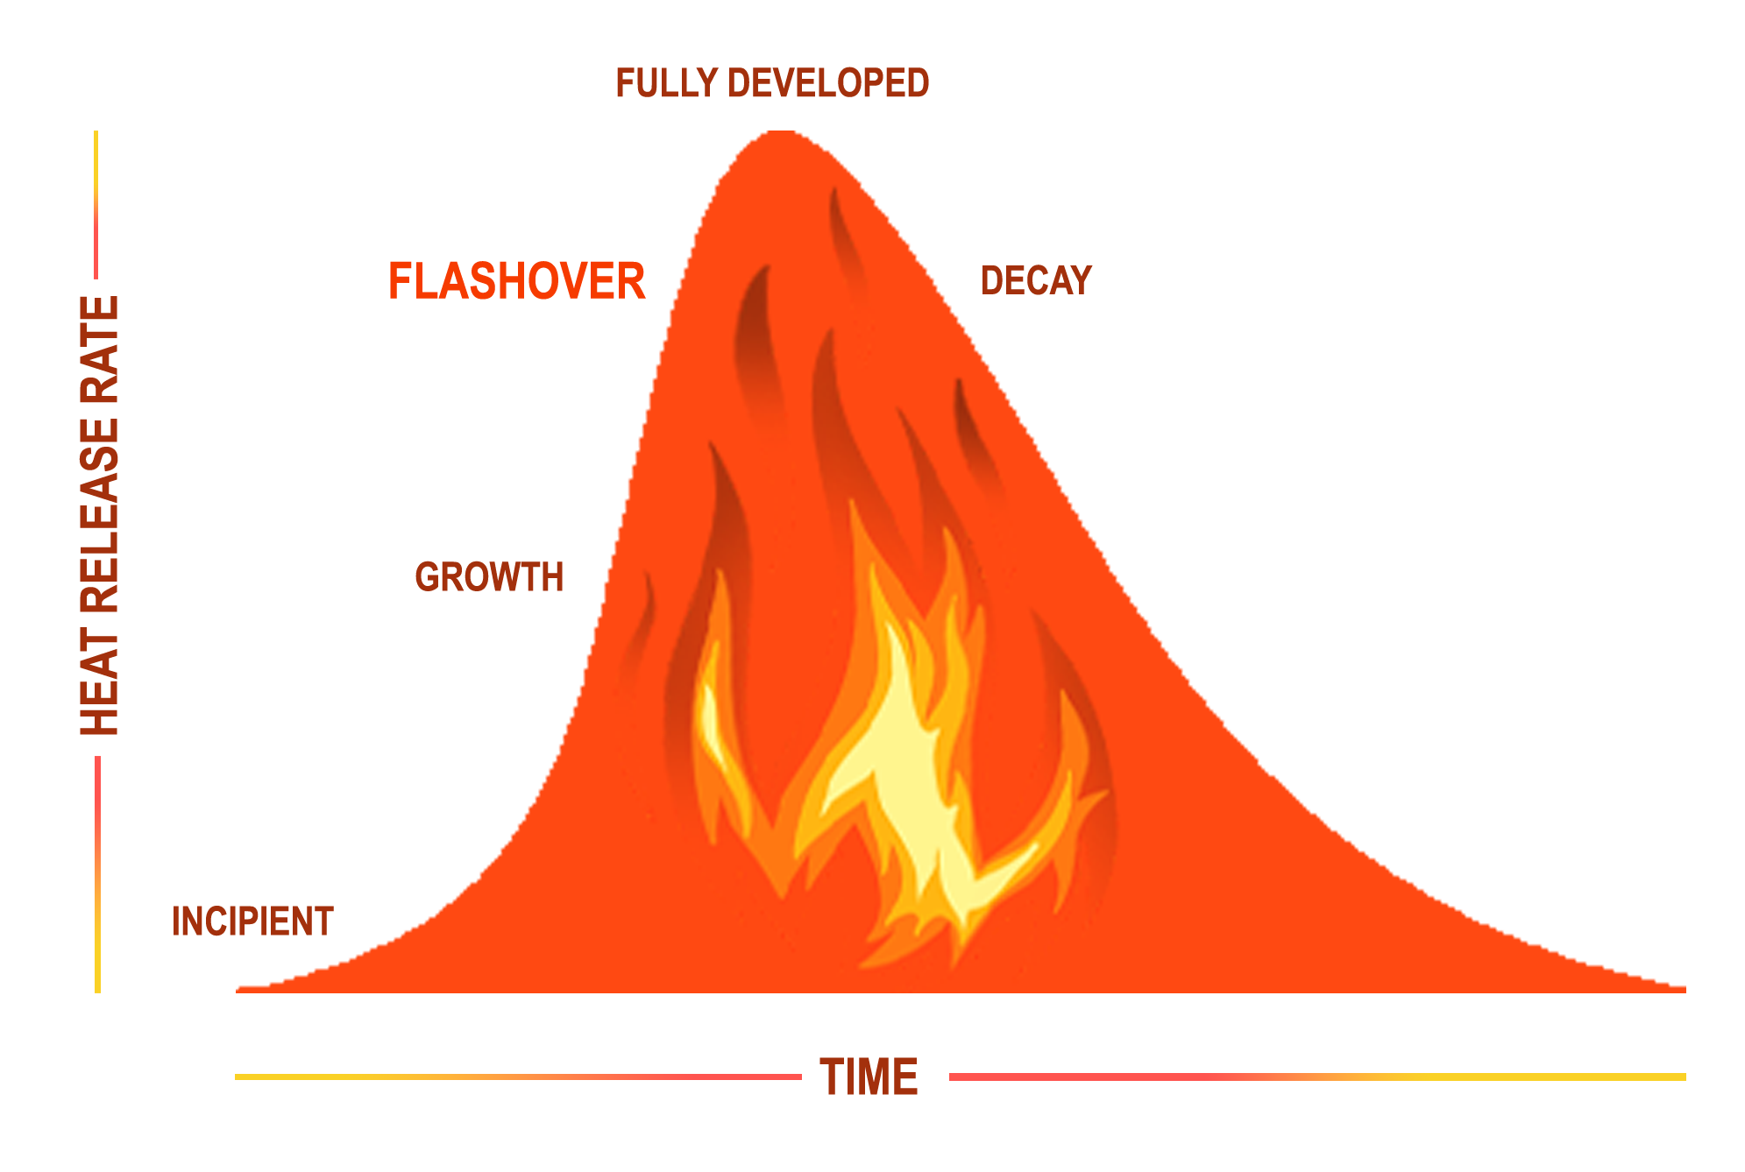
Fire Stages
Fire extinguishers only on incipient stage fires
Fire doubles in size every 30 seconds

Slide 5
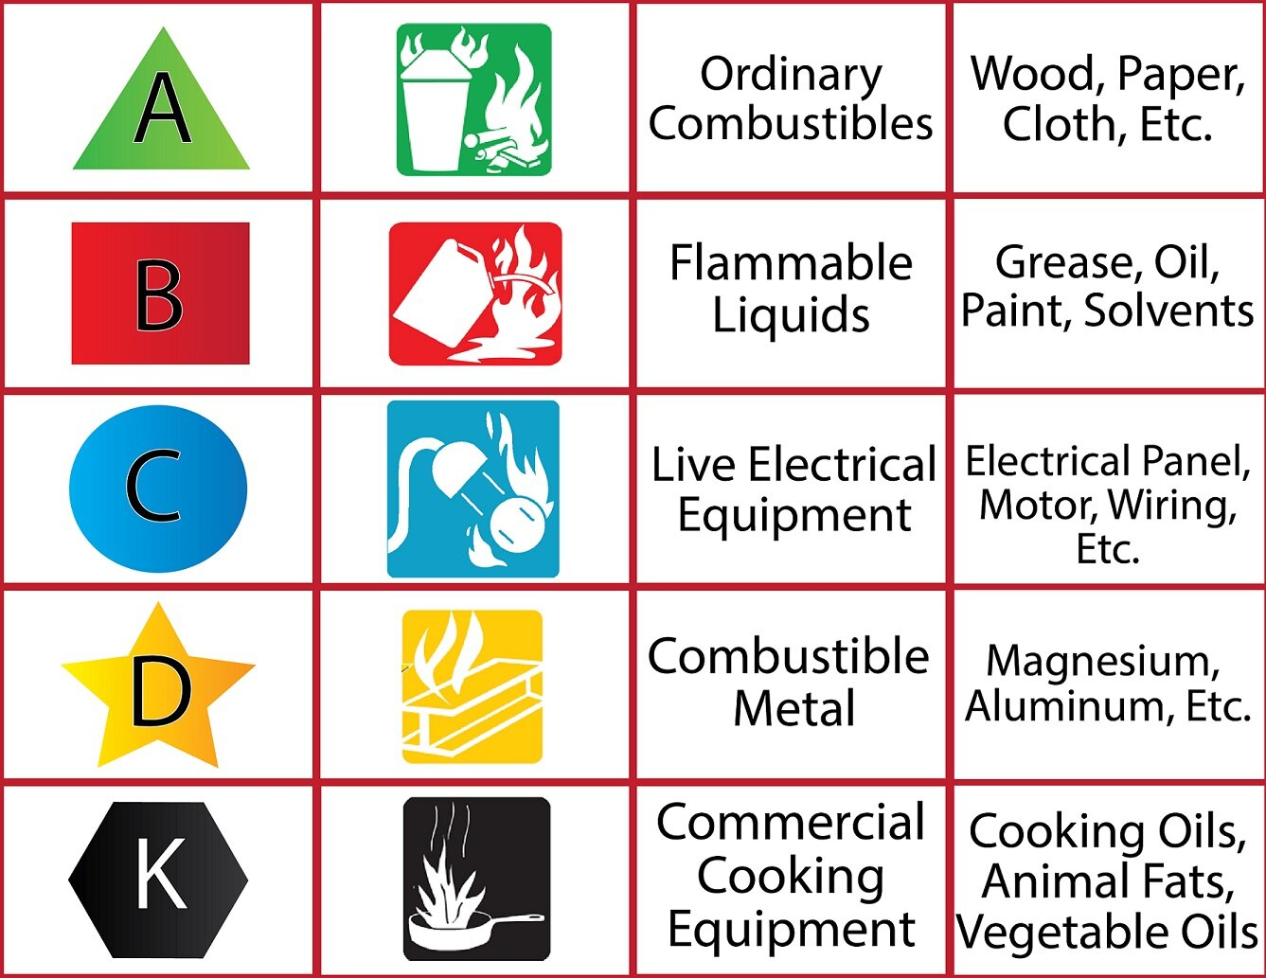
Fire Classes

Slide 6
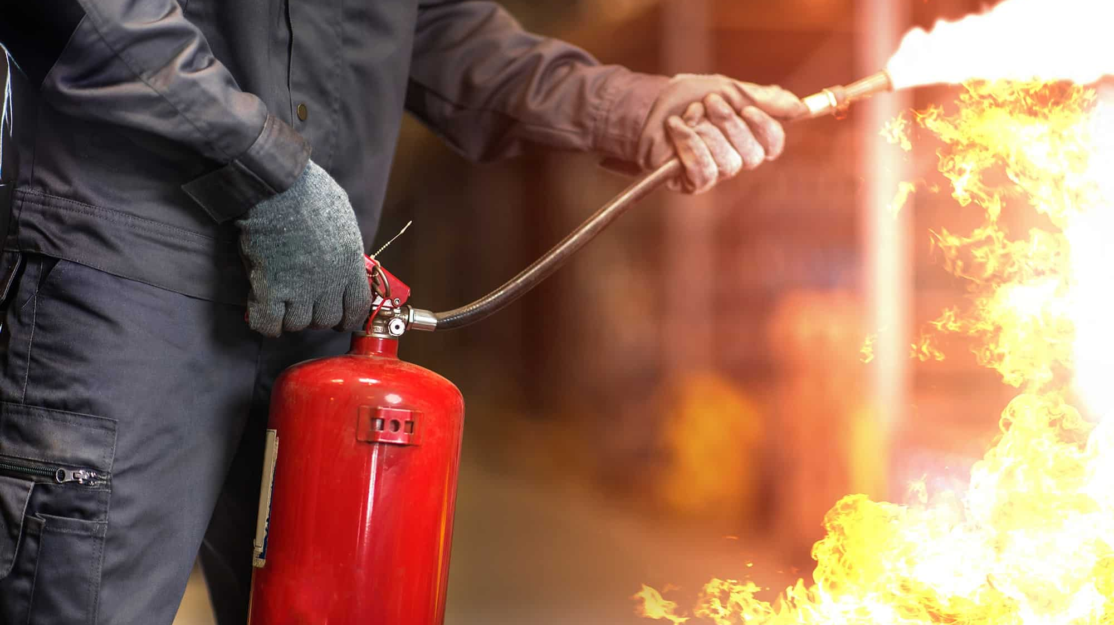
Fire Extinguisher Use
The Basics

Slide 7
Firefighting Decision Criteria
Understand the Fire Prevention Plan and Emergency Action/Response Plan
Know your evacuation route and assembly areas.
Know locations of extinguishers in your area and how to use them.
Always sound the alarm regardless of fire size
Avoid smoky conditions, smoke kills!
Ensure area is evacuated.
If you are attempting to fight the fire:
  Alarm already sounded
  Fire is the incipient phase (Small and Contained)
  You have a clear route to safety. DO NOT ALLOW THE FIRE TO GET BEHIND YOU!
  Extinguisher is rated for size and type of fire. Class BC will not put out a Class A Fire, it will just spread it.
If in doubt, get out!
Notes:
ASK “HOW DO I DECIDE TO FIGHT THE FIRE OR EVACUATE?”
IF ONE OR MORE OF THE ABOVE CRITERIA AREN’T MET, BUG OUT!
IF YOU DO USE AN EXTINGUISHER, PLACE IT OUT OF SERVICE AND NOTIFY THE APPROPRIATE PERSON(S) SO IT CAN BE RECHARGED OR REPLACED.

Slide 8
Fire Extinguisher Anatomy
PRESSURE GAUGE
(not found on CO₂
extinguishers)
DISCHARGE LEVER
DISCHARGE LOCKING PIN
AND SEAL
CARRYING
HANDLE
DISCHARGE HOSE
DATA PLATE
DISCHARGE NOZZLE
BODY
DISCHARGE ORIFICE
Notes:
Slide is from Willis Fire Protection Company

Slide 9
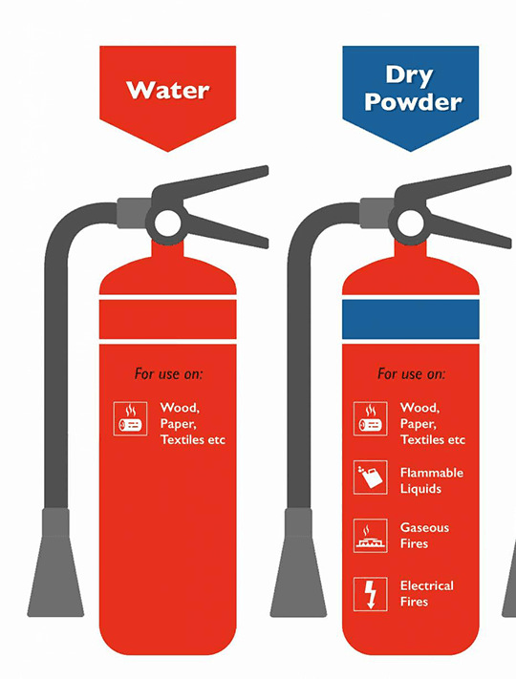
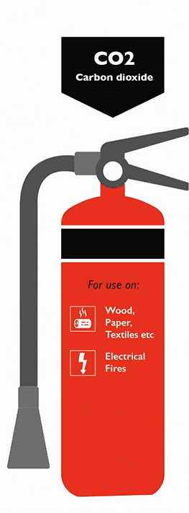
Fire Extinguisher Types
A
ABC
BC
Notes:
Class “A” fires only
2.5 gal. water (up to 1 minute discharge time)
Has pressure gauge to allow visual capacity check
30-40 ft. maximum effective range
Can be started and stopped as necessary
Extinguishes by cooling burning material below the ignition point.
Class “B” or “C” fires
2.5-100 lb. of CO₂ (8-30 seconds discharge time)
Has NO pressure gauge--capacity verified by weight
3-8 ft. maximum effective range
Extinguishes by smothering burning materials
Effectiveness decreases as temperature of burning material increases.
Class “A”, “B”, or “C” fires
2.5-20 lb. dry chemical (ammonium phosphate) 8-25 seconds discharge time)
Has pressure gauge to allow visual capacity check
5-20 ft. maximum effective range
Extinguishes by smothering burning materials.

Slide 10
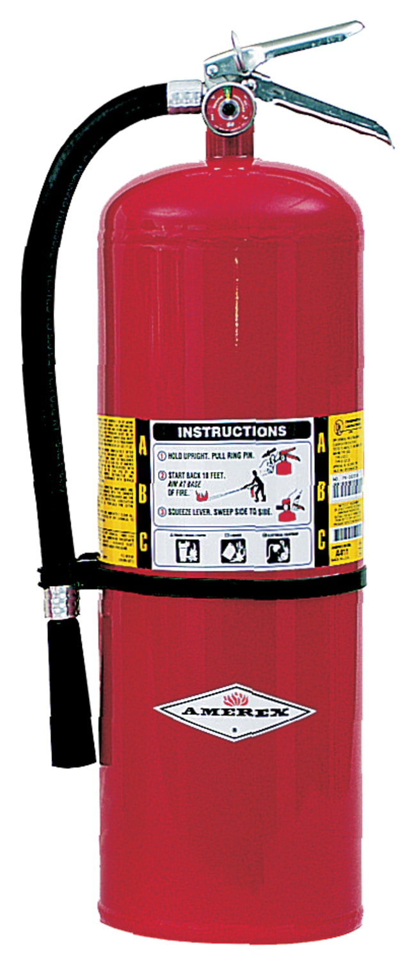
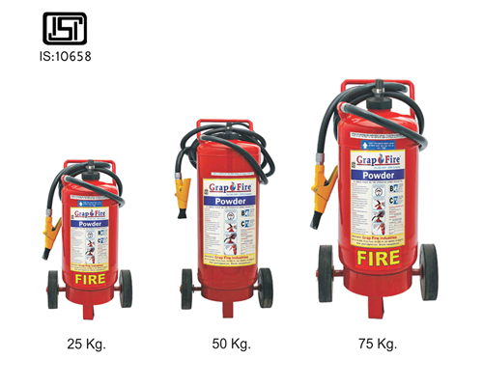
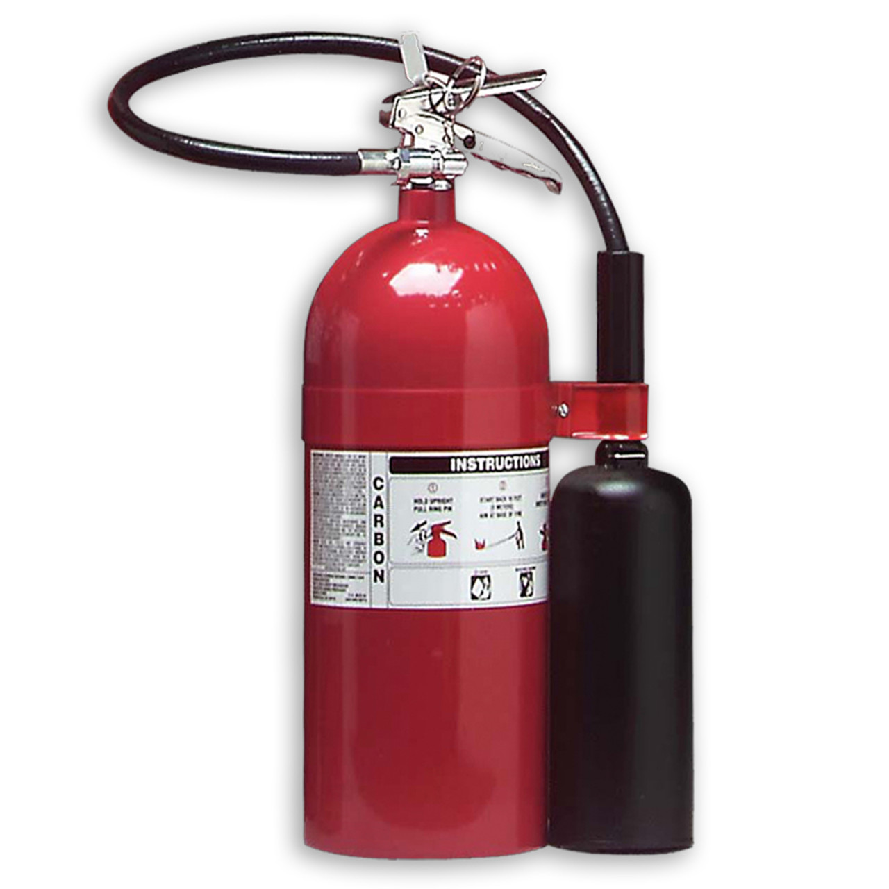
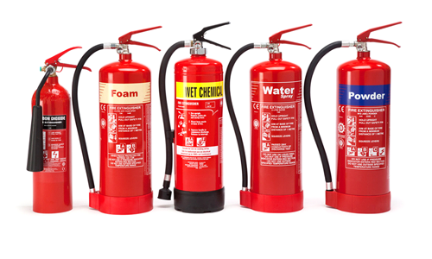
Fire Extinguisher Examples

Slide 11
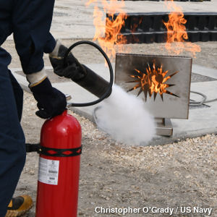
How to Use a Fire Extinguisher: PASS
Pull
Pull the Pin
Aim
Aim the Nozzle at the Base of the Fire
Squeeze
Squeeze the Handle
Sweep
Sweep Side to Side

Slide 12
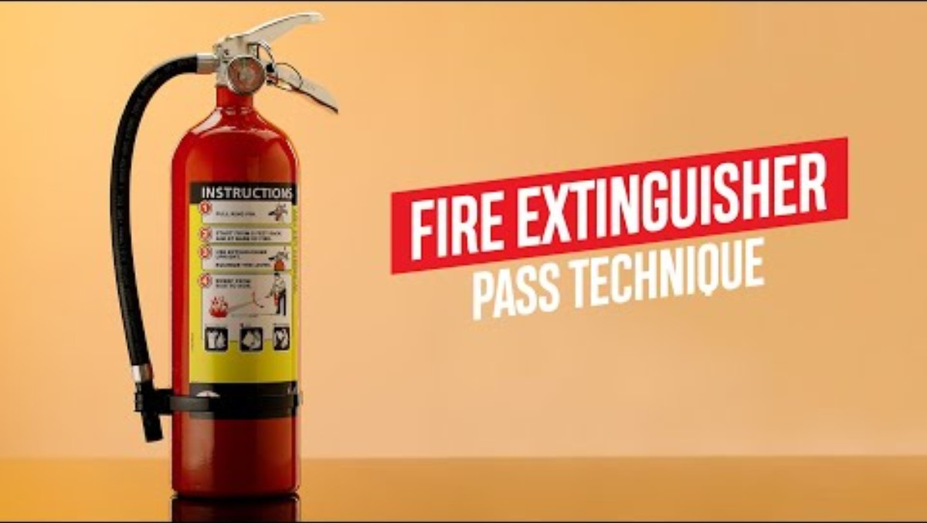
How to Use a Fire Extinguisher
PASS Video Demonstration

Slide 13
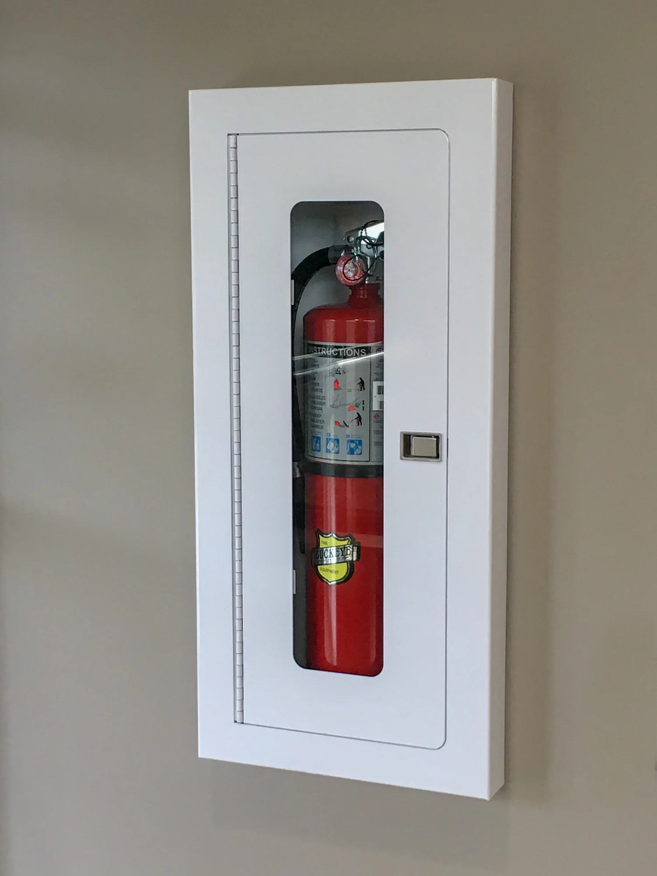
Fire Extinguisher Mounting
Fire extinguisher should be mounted so that the top of the extinguisher is no more than 5 feet above the floor if it weighs 40 pounds or less.
If the Extinguisher weights more than 40 pounds; no more than 3.5 feet above the floor.
The bottom of the extinguisher should always be at least 4 inches off the ground.
Label Must Face Outwards

Slide 14
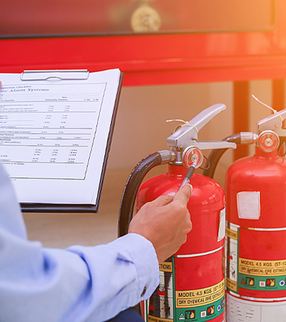
Fire Extinguisher Inspections
Fire Extinguishers should be inspected monthly, by anyone that understands how they are used.
  Extinguishers must be fully charged to pass inspection.
  Pins should still be in place
  If you find any sign of use, damage, or have any questions, inform your supervisor, and take it out of service.
Annual and Periodic Inspections
  Completed by a Certified Fire Extinguisher Service Professional
  Servicing is typically performed offsite

Slide 15

Questions

Slide 16

Appendix A: Acknowledgements
Willis Fire Safety Power Point Presentation
Fire Protection and Prevention – OSHA Website Information
1910 Subpart E – Exit Routes and Emergency Planning
  1910.35 – Exit Route Codes
  1910.36 – Design and Construction Requirements for Exit Routes
  1910.37 – Maintenance of Exit Routes
  1910.38 – Emergency Action Plans
  1910.39 – Fire Prevention Plans
1910 Subpart H – Hazardous Materials
  1910.106 – Flammable Liquids
  1910.110 – Storage and Handling of Liquified Petroleum Gases
1910 Subpart L – Fire Protection
  1910.157 – Fire Extinguishers – Portable
  1910.158 – Standpipes and Hose Systems
  1910.159 – 1910.163 – Fixed Extinguishing Systems, Sprinklers
  1910.164 – Fire Detection Systems
1910 Subpart Q – Welding, Cutting, Brazing
  1910.252 – General Requirements
    1910.252(a)(2)(iii) – Fire Watch
      No combustible materials within 35 feet (10.7m)
      30 Minutes after work has completed
      NFPA is recommending to change to 1 hour, not updated yet by OSHA, but will most likely be changed at some point.
1910 Subpart Z – Toxic and Hazardous Substances
  1910.1200 – Hazardous Communication

